Slide 1
The State of the Nation’s Housing 2023 Figure Data (Public)

Slide 2
Figure 1: Home Price and Apartment Rent Growth Continued Sharp Decline in Early 2023
Notes: Asking rents are for professionally managed apartments in buildings with five or more units. Home prices in 2023q1 reflect data for January and February only.
Source: JCHS tabulations of RealPage data; S&P CoreLogic Case-Shiller US National Home Price Index.

Slide 3
Figure 2: Steeply Rising Rates Have Made Payments on the Median-Priced Home Much More Expensive
Monthly Mortgage Payment (Dollars)
Note: Monthly mortgage payments include principal, interest, taxes, and insurance (PITI) and assume a 3.5% downpayment on a 30-year fixed-rate loan, 0.85% mortgage insurance, 0.35% property insurance, and 1.15% property taxes.
Source: JCHS tabulations of Freddie Mac, Primary Mortgage Market Surveys; National Association of Realtors (NAR), Existing Home Sales.

Slide 4
Figure 3: Single-Family Construction Dropped Dramatically, While Multifamily Development Remained Strong
Note: Single-family and multifamily historical averages are of seasonally adjusted monthly data from January 1990 to March 2023.
Source: JCHS tabulations of US Census Bureau, New Residential Construction.

Slide 5
Figure 4: Number of Cost-Burdened Renters Reached an All-Time High in 2021
Notes: Moderately (severely) cost-burdened households spend more than 30% (more than 50%) of income on housing. Estimates for 2020 are omitted due to data collection issues experienced during the pandemic.
Source: JCHS tabulations of US Census Bureau, American Community Survey 1-Year Estimates.

Slide 6
Figure 5: Unsheltered Homelessness Continued Rising in 2022, Even as Fewer People Stayed in Shelters
Notes: People experiencing sheltered homelessness are those staying in emergency shelters, transitional housing programs, or
safe havens. People experiencing unsheltered homelessness are those whose primary nighttime location is a place not intended for human habitation.
Source: JCHS tabulations of HUD, Annual Homeless Assessment Report Point-in-Time Estimates.

Slide 7
Figure 6: Across Income Levels, People of Color Disproportionately Live in High-Poverty Areas
Race/Ethnicity
Notes: High-poverty census tracts are those where at least 20% of the population has incomes below the poverty line, as defined by the official measure of poverty established by the Office of Management and Budget. Individuals in the white category are non-Hispanic. Because Hispanic individuals may be of any race, some other racial categories overlap.
Source: JCHS tabulations of US Census Bureau, 2021 American Community Survey 5-Year Estimates.

Slide 8
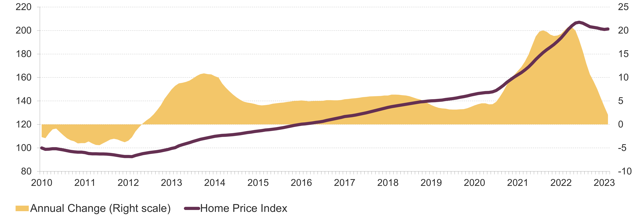
Figure 7: Despite Slowing Growth, Home Prices Remain Near Record Highs
Home Price Index
Annual Change (Percent)
Source: JCHS tabulations of S&P CoreLogic Case-Shiller US National Home Price Index.

Slide 9
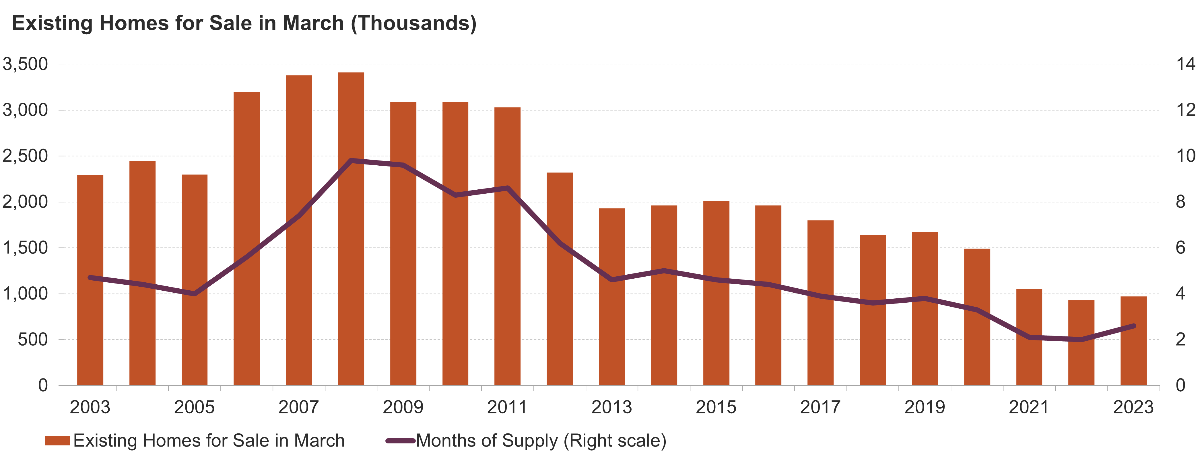
Figure 8: Supply of Homes for Sale Remained Near Record Lows in Early 2023
Months of Supply
Note: Months of supply measures how long it would take homes on the market to sell at the current rate. Six months is typically considered a balanced market.
Source: JCHS tabulations of NAR, Existing Home Sales.

Slide 10
Figure 9: Across the Country, Rent Growth Slowed in Early 2023
West
South
Northeast
Midwest
Notes: Asking rents are for professionally managed apartments in buildings with five or more units. Figure shows the markets in each region with the lowest and highest annual change in asking rents in 2023q1.
Source: JCHS tabulations of RealPage data.

Slide 11
Figure 10: Demand for Professionally Managed Apartments Fell Sharply into Early 2023
Note: Data are for professionally managed apartment buildings with five or more units.
Source: JCHS tabulations of RealPage data.

Slide 12
Figure 11: Construction Pipeline Hovers Near Record High in Early 2023, Fueled by Multifamily Development
Source: JCHS tabulations of US Census Bureau, New Residential Construction.

Slide 13
Figure 12: Household Growth Slowed in 2022 but Remained Above Pre-Pandemic Levels
Source: JCHS tabulations of US Census Bureau, Housing Vacancy Surveys.

Slide 14
Figure 13: Population Growth Still Near Record Lows in 2022, Despite a Rebound in Immigration
Note: Natural population change is the difference between births and deaths.
Source: JCHS tabulations of US Census Bureau, Population Estimates Program.

Slide 15
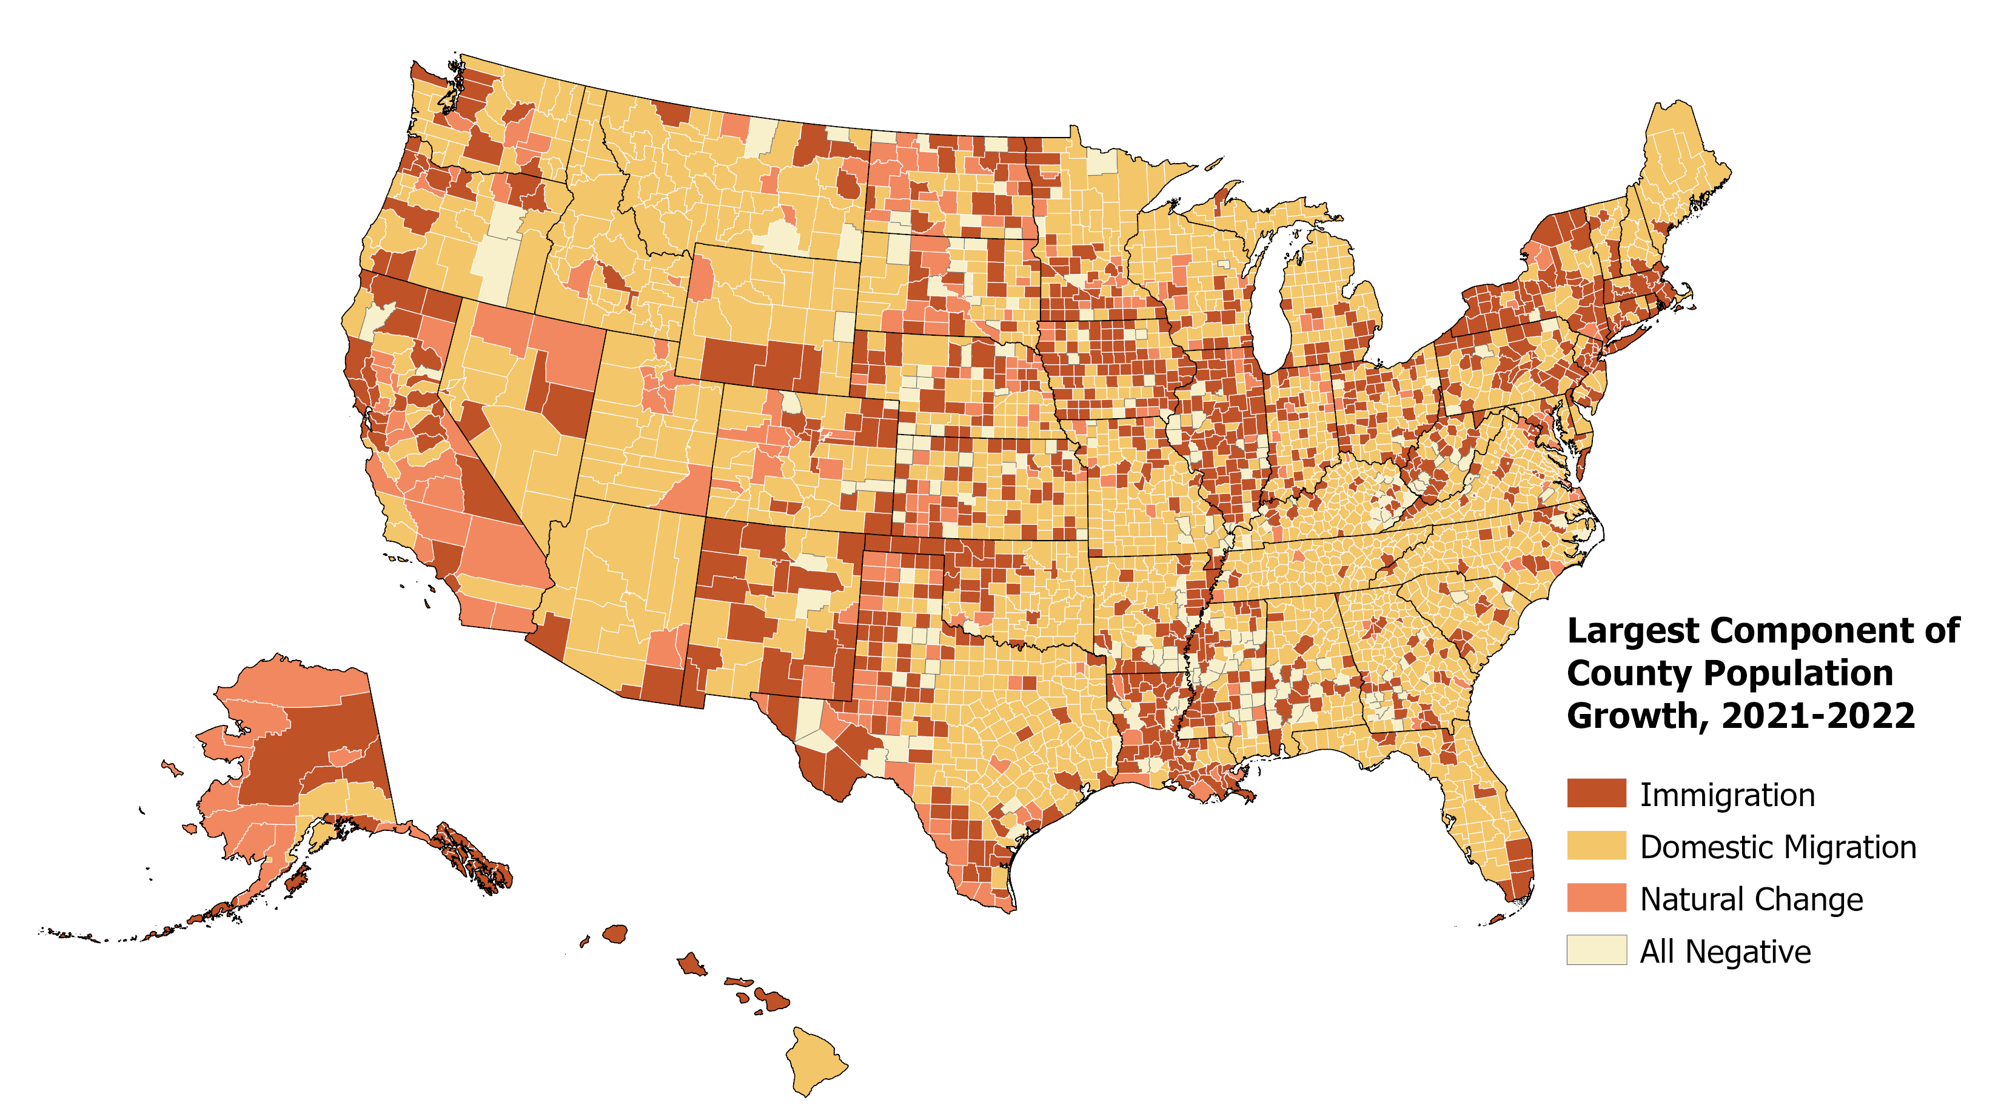
Figure 14: Immigration Was the Largest Source of Population Growth in Nearly a Third of Counties in 2022
Notes: Natural population change is the difference between births and deaths. “All negative” means that each component of population change was negative in 2021-2022.
Source: JCHS tabulations of US Census Bureau, 2022 Population Estimates Program.
Notes:
https://codepen.io/JCHS-Riordan/full/xxyKrWM

Slide 16
Figure 15: Moves from Core Counties to Smaller and Rural Markets Accelerated During the Pandemic
County Location
Notes: Large metro areas have at least 1 million residents. Core counties contain either the largest city in the metro area or any city with at least 250,000 residents. Non-core counties are all other counties in large metro areas.
Source: JCHS tabulations of US Census Bureau, 2022 Population Estimates Program.

Slide 17
Figure 16: Older Adults Are Increasingly Driving Household Growth
Age of Household Head
Source: JCHS tabulations of US Census Bureau, Housing Vacancy Surveys.

Slide 18
Figure 17: Higher Interest Rates Eroded Affordability Over the Past Year
 | March 2022 | March 2023 | Percent Change
Interest Rate (Percent) | 4.2 | 6.5 | +57
Median Home Price (Dollars) | 379,300 | 375,400 | -1
Downpayment & Closing Costs | 24,700 | 24,400 | -1
Monthly Mortgage Payment | 1,780 | 2,300 | +29
Total Monthly Owner Costs | 2,500 | 3,000 | +20
Required Annual Income | 97,400 | 117,100 | +20
Note: Estimates assume a 3.5% downpayment on a 30-year fixed-rate loan, 0.85% mortgage insurance, 0.35% property insurance, 1.15% property taxes, 3% closing costs, and a maximum 31% debt-to-income ratio.
Source: JCHS tabulations of Freddie Mac, Primary Mortgage Market Surveys; NAR, Existing Home Sales.

Slide 19
Figure 18: Number of Cost-Burdened Homeowners Rose Sharply in 2021, a First Since the Mid-2000s
Notes: Moderately (severely) cost-burdened households spend more than 30% (more than 50%) of income on housing. Estimates for 2020 are omitted due to data collection issues experienced during the pandemic.
Source: JCHS tabulations of US Census Bureau, American Community Survey 1-Year Estimates.

Slide 20
Figure 19: Growth in Homeowner Households Continued to Lift Homeownership Rates in 2022
Note: Estimates for 2020 are omitted due to data collection issues experienced during the pandemic.
Source: JCHS tabulations of US Census Bureau, Housing Vacancy Surveys.

Slide 21
Figure 20: Home Equity Has Reached Unprecedented Heights as Mortgage Debt Holds Steady
Note: Homeowner equity and mortgage debt are adjusted for inflation using the CPI-U for All Items Less Shelter.
Source: JCHS tabulations of US Federal Reserve Board, Financial Accounts of the United States.

Slide 22
Figure 21: Despite the Recent Rise in Homeownership Rates, Large Disparities Persist by Race and Ethnicity
Race/Ethnicity
Notes: Householders who are white, Black, and Asian or another race are non-Hispanic. Hispanic householders may be of any race.
Source: JCHS tabulations of US Census Bureau, Housing Vacancy Surveys.

Slide 23
Figure 22: Rentership Rates Declined as Renter Household Growth Slowed in 2022
Note: Estimates for 2020 are omitted due to data collection issues experienced during the pandemic.
Source: JCHS tabulations of US Census Bureau, Housing Vacancy Surveys.

Slide 24
Figure 23: Despite Slowing Rent Growth, Rent Increases Remain Above Pre-Pandemic Levels
Notes: Asking rents are for professionally managed apartments in buildings with five or more units. Class A (Class C) apartments are relatively higher (lower) quality.
Source: RealPage.

Slide 25
Figure 24: Large Multifamily Buildings Constituted the Bulk of Rental Stock Growth in the Last Decade
Number of Rental Units (Millions)
Notes: Rental units may be occupied, vacant for rent, or rented but unoccupied. Estimates for 2020 are interpolated due to data collection issues experienced during the pandemic.
Source: JCHS tabulations of US Census Bureau, American Community Survey 1-Year Estimates.

Slide 26
Figure 25: The Stock of Low-Rent Units Continues to Shrink
Share of Rental Stock (Percent)
Notes: Low-rent units have contract rents under $600. Rents are inflated to 2021 dollars using the CPI-U for All Items Less Shelter. No-cash units are excluded.
Source: JCHS tabulations of US Census Bureau, American Community Survey 1-Year Estimates.

Slide 27
Figure 26: Across Income Levels, Cost Burden Rates Increased for Renters in 2021
Share of Cost-Burdened Renter Households (Percent)
Notes: Incomes are adjusted for inflation using the CPI-U for All Items. Cost-burdened households spend more than 30% of income on housing.
Source: JCHS tabulations of US Census Bureau, American Community Survey 1-Year Estimates.

Slide 28
Figure 27: Costs of Building Materials Have Surged Since the Start of the Pandemic
Note: Inputs to new residential construction is not a composite of the other components and excludes capital, labor, and imports.
Source: JCHS tabulations of US Bureau of Labor Statistics, Producer Price Indexes.

Slide 29
Figure 28: Rental Subsidies Have Increasingly Shifted to Tenant-Based Assistance and Tax Credits
Notes: LIHTC occupancy is based on the 98.6% rate reported by Novogradac in 2021. LIHTC units include low-income units only.
Source: JCHS tabulations of HUD, Picture of Subsidized Housing Reports and Low-Income Housing Tax Credit Database; Robert Collinson, Ingrid Gould Ellen, and Jens Ludwig, Low-Income Housing Policy, NBER Working Paper, 2015.

Slide 30
Figure 29: Evictions Returned to Historic Average by Late 2022
Notes: Data include eviction filings in 10 states and 34 cities. Rates are filings relative to a pre-pandemic average baseline.
Source: JCHS tabulations of Eviction Lab, Eviction Tracking System through December 31, 2022.

Slide 31
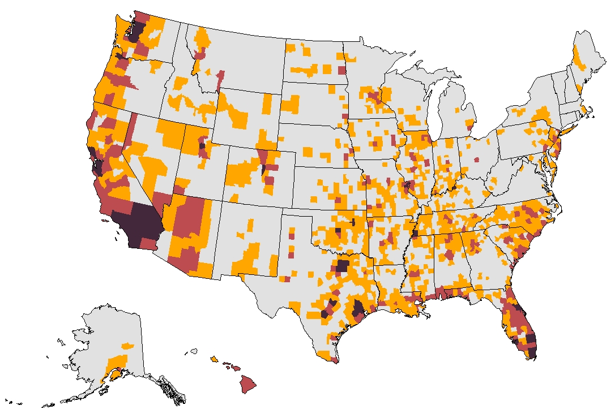
Figure 30: Across the Country, More Than 59 Million Homes Are Threatened by Climate-Related Disasters
Number of Units
In High-Risk Counties
Under 10,000
10,000–49,999
50,000–199,999
200,000 and Over
Notes: High-risk areas have a relatively moderate, relatively high, or very high expected annual loss (EAL) score. EAL represents the average annual dollar loss resulting from natural hazards. The number of units in high-risk counties is aggregated from the tract level.
Source: JCHS tabulations of Federal Emergency Management Agency, November 2021 National Risk Index EAL data; US Census Bureau, 2021 American Community Survey 5-Year Estimates.

Slide 32
Figure 31: Racial Segregation Persists Across the Country
Note: Neighborhoods are census tracts.
Source: Brown University, Diversity and Disparities Project estimates of US Census Bureau, 2020 Decennial Census.

