Slide 1
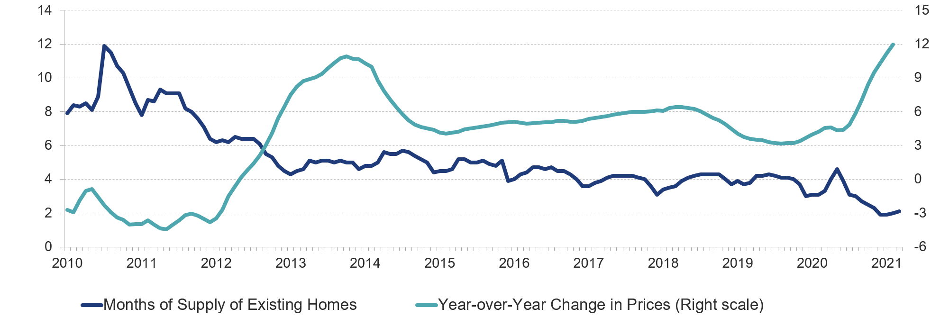
Figure 1: With Inventories at Record Lows, Existing Home Prices Continue to Head Up
Months of Supply
Change in Prices (Percent)
Note: Months of supply measures how long it would take the number of homes on the market to sell at the current rate, where six months is typically considered a balanced market.
Source: JCHS tabulations of National Association of Realtors (NAR), Existing Home Sales; S&P CoreLogic Case-Shiller US National Home Price Index.

Slide 2
Figure 2: Home Price-to-Income Ratios in an Increasing Number of Metro Areas Are Back Near Mid-2000s Levels
Number of Metro Areas
US Ratio
Notes: Price-to-income ratios are for the 100 largest metro areas by population. Income data for 2020 are based on Moody’s Analytics forecasts.
Source: JCHS tabulations of NAR, Metropolitan Median Area Prices; Moody’s Analytics estimates.

Slide 3
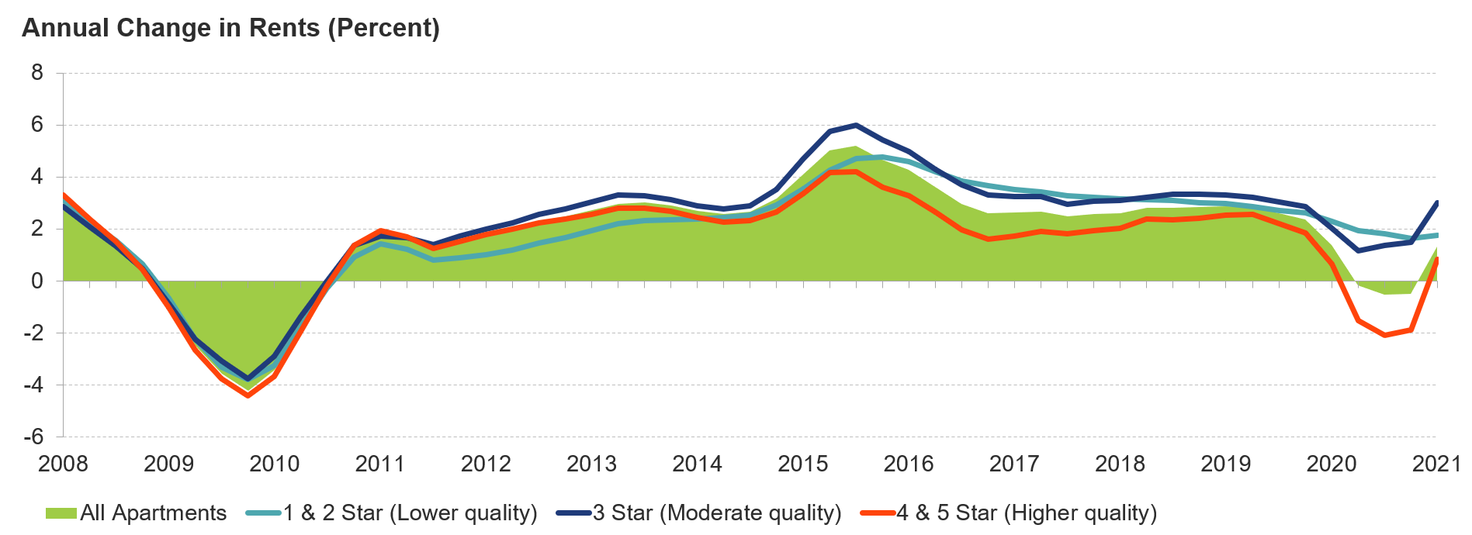
Figure 3: Following a Dip Early in the Pandemic, Rents for High-Quality Apartments Are Again on the Rise
Note: Apartment quality is based on the CoStar Building Rating System for professionally managed market-rate apartments in buildings with five or more units.
Source: JCHS tabulations of CoStar data.

Slide 4
Figure 4: Households of Color and Renters Are More Likely to Have Fallen Behind on Monthly Housing Payments
Notes: Households behind on rent or mortgage reported that they were not caught up at the time of survey. Black, white, and Asian households are non-Hispanic. Hispanic households may be of any race.
Source: JCHS tabulations of US Census Bureau, Household Pulse Surveys, January–March 2021.

Slide 5
Figure 5: The Number of High-Cost Disasters Set a New Record in 2020
Notes: All costs are adjusted to 2020 dollars using the CPI-U for All Items. The direct costs of disasters include physical damage to buildings, material assets, vehicles, infrastructure, and agriculture, as well as the costs of business interruption, wildfire suppression, and disaster restoration.
Source: JCHS tabulations of National Oceanic and Atmospheric Administration (NOAA), Billion-Dollar Weather and Climate Disasters

Slide 6
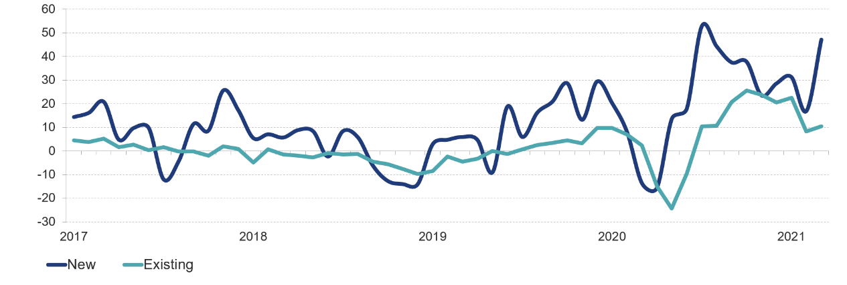
Figure 6: After a Brief Pause Early in the Pandemic, the Pace of Home Sales Has Remained Brisk
Year-over-Year Change in Single-Family Home Sales (Percent)
Source: JCHS tabulations of NAR, Existing Home Sales; US Census Bureau, New Residential Sales.

Slide 7
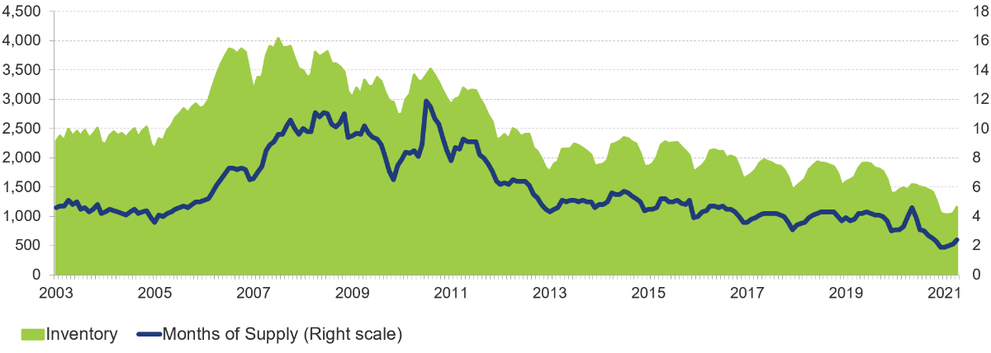
Figure 7: Inventories of Homes for Sale Fell to a Record Low in Early 2021
Homes for Sale (Thousands)
Months of Supply
Note: Months of supply measures how long it would take the number of homes on the market to sell at the current rate, where six months is typically considered a balanced market.
Source: JCHS tabulations of NAR, Existing Home Sales.

Slide 8
Figure 8: The Pace of Both Single-Family and Multifamily Construction Has Exceeded Historical Averages for Nearly a Year
Note: Single-family and multifamily historical averages are of seasonally adjusted monthly data from January 1990 to March 2021.
Source: JCHS tabulations of US Census Bureau, New Residential Construction data.

Slide 9
Figure 9: Single-Family Construction Continued to Strengthen Across Markets Last Year Even as Multifamily Construction Hit a Pause, Particularly in Core Counties
Single-Family Permits (Thousands)
Multifamily Permits (Thousands)
Notes: Large metro areas have at least one million residents. Core counties contain either the largest city in the metro area or any city with over 250,000 residents. Non-core counties are all other counties in large metro areas.
Source: JCHS tabulations of US Census Bureau, Building Permits Survey via Moody’s Economy.com.

Slide 10
Figure 10: Sharply Rising Lumber Prices Have Driven Up the Materials Costs of Residential Construction Since the Start of the Pandemic
Annual Change in Prices (Percent)
Note: Inputs to new residential construction exclude capital, labor, and imports.
Source: JCHS tabulations of Bureau of Labor Statistics, Producer Price Indexes.

Slide 11
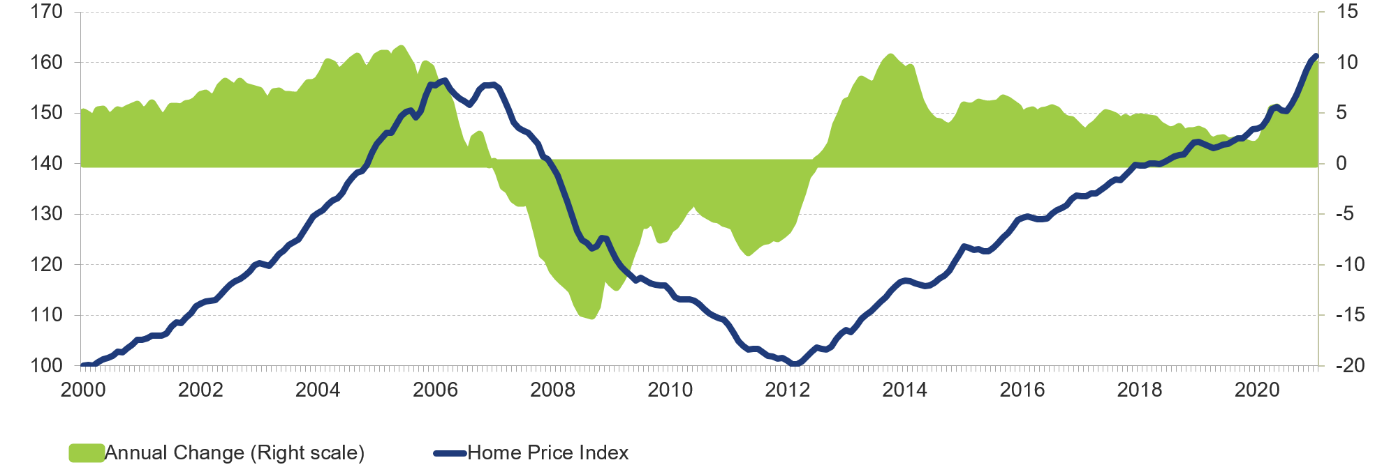
Figure 11: Real Home Prices Have Continued to Climb for Nearly a Decade
Home Price Index
Annual Change (Percent)
Note: Real home prices are adjusted for inflation using the CPI-U for All Items less shelter.
Source: JCHS tabulations of S&P CoreLogic Case-Shiller US National Home Price Index.

Slide 12
Figure 12: Early Evidence Points to a Consistent Pickup in Household Growth Despite the Pandemic
Average Annual Increase in Households (Millions)
Note: Estimate for 2021:1 is the year-over-year change in the first quarter.
Source: JCHS tabulations of US Census Bureau, Housing Vacancy Surveys and American Community Survey 1-Year Estimates.

Slide 13
Figure 13: Younger Adults Have Given an Increasingly Large Lift to Household Growth
Note: Data are 3-year rolling annual averages to reduce volatility.
Source: JCHS tabulations of US Census Bureau, American Community Survey 1-Year Estimates.

Slide 14
Figure 14: After Retreating to Their Parents’ Homes Last Summer, Many Young Adults Were Living on Their Own Again by Early 2021
Note: Data exclude people enrolled full time in college or university.
Source: JCHS tabulations of US Census Bureau, Current Population Survey via IPUMS CPS, University of Minnesota, www.ipums.org.

Slide 15
Figure 15: Household Growth Outside the Cities of Large Metro Areas Was Accelerating Well Before the Pandemic
Notes: Large metro areas have at least one million residents. City tracts are either in the metro’s principal city or in cities with populations over 100,000. All non-city tracts in metro areas are suburban.
Source: JCHS tabulations of US Census Bureau, American Community Survey 5-Year Estimates.

Slide 16
Figure 16: Wide Disparities in Wealth Leave Renters at a Large Disadvantage in the Housing Market
Median Household Wealth (Dollars)
 | Owners | Renters | All Households
All Households | 254,900 | 6,270 | 121,760
Race/Ethnicity
Black | 113,130 | 1,830 | 24,100
Hispanic | 164,800 | 5,800 | 36,050
Asian and All Other Races | 299,000 | 6,710 | 74,500
White | 299,900 | 8,900 | 189,100
Income Quartile
Bottom | 108,100 | 1,900 | 10,700
Lower Middle | 161,000 | 8,300 | 64,800
Upper Middle | 240,200 | 20,700 | 164,000
Top | 703,000 | 154,000 | 627,000
Notes: White, Black, and Asian and all other race households are non-Hispanic. Hispanic households may be of any race.
Source: JCHS tabulations of the Federal Reserve Board, 2019 Survey of Consumer Finances.

Slide 17
Figure 17: Sharp Declines in Both Natural Increase and Immigration Left Population Growth in 2020 at Half Its Previously Projected Level
Projected
Note: Natural increase is the difference between the number of births and the number of deaths in the resident population.
Source: JCHS tabulations of US Census Bureau, vintage 2020 Population Estimates and 2017 Population Projections.

Slide 18
Figure 18: Despite the Pandemic, the National Homeownership Rate Remained on the Rise Over the Past Year
Homeowner Households (Millions)
Homeownership Rate (Percent)
Notes: Data for 2014–2019 are annual. Data for 2020 and 2021 are for the first quarter.
Source: JCHS tabulations of US Census Bureau, Housing Vacancy Surveys.

Slide 19
Figure 19: Declining Interest Rates Have Offset the Rise in Home Prices, Preventing a Sharp Increase in the Real Monthly Cost of Homeownership
Index
Notes: House prices and monthly homeowner costs are adjusted to 2020 dollars using the CPI-U for All Items less shelter. Monthly homeowner costs assume a 3.5% downpayment on a median-priced, existing single-family home (including condos and coops); property taxes of 1.15%, property insurance of 0.35%, and mortgage insurance of 0.85%.
Source: JCHS tabulations of Moody’s Analytics estimates; US Census Bureau, Current Population Surveys; and Freddie Mac, Primary Mortgage Market Surveys.

Slide 20
Figure 20: Large Shares of Low-Income Homeowners and Households of Color Were Behind on Their Mortgages in Early 2021
Share of Homeowners Behind on Mortgage Payments in 2021:1 (Percent)
Household Income
Race/Ethnicity
Age of Household Head
Notes: Households behind on their mortgages reported that they were not caught up at the time of the survey. Household income is for 2019. Black, Asian, and white households are non-Hispanic. Hispanic households may be of any race.
Source: JCHS tabulations of US Census Bureau, Household Pulse Surveys, January–March 2021.

Slide 21
Figure 21: Homeowners of Color and Borrowers with Little Equity Were Especially Likely to Be in Forbearance in Early 2021
Share of Mortgage Holders in Forbearance (Percent)
Notes: Data exclude first liens on manufactured homes. White, Black, and all other race borrowers are non-Hispanic. Hispanic households may be of any race. Equity share is the homeowner’s equity as a share of home value. All mortgages in forbearance include loans only on single-family homes.
Source: Consumer Finance Protection Bureau, Characteristics of Mortgage Borrowers During the COVID-19 Pandemic, March 2021.

Slide 22
Figure 22: Mortgage Refinancing Activity Surged Last Year, Spurred by Record-Low Interest Rates
Volume (Billions of dollars)
Note: Data are benchmarked to annual Home Mortgage Disclosure Act (HMDA) data, adjusted for market coverage.
Source: JCHS tabulations of Mortgage Bankers Association data.

Slide 23
Figure 23: Homeownership Gaps for Households of Color Persist Across All Age Groups
Homeownership Rate (Percent)
Notes: White, Asian, Native American, and Black households are non-Hispanic. Hispanics may be of any race.
Source: JCHS tabulations of US Census Bureau, 2019 American Community Survey 1-Year Estimates.

Slide 24
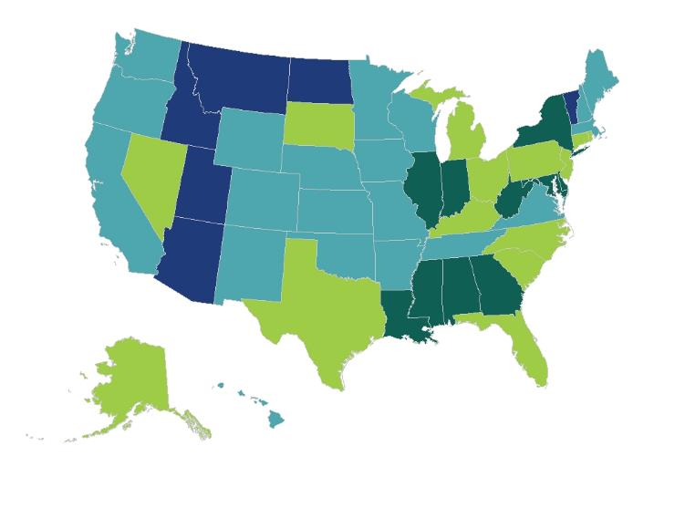
Figure 24: More than a Fifth of Households in Several States Struggled to Pay Rent in Early 2021
Share of Renters (Percent)
Less Than 12
12-15
16-19
20 and Over
Note: Households behind on rent reported that they were not caught up at the time of survey.
Source: JCHS tabulations of US Census Bureau, Household Pulse Surveys, January–March 2021.

Slide 25
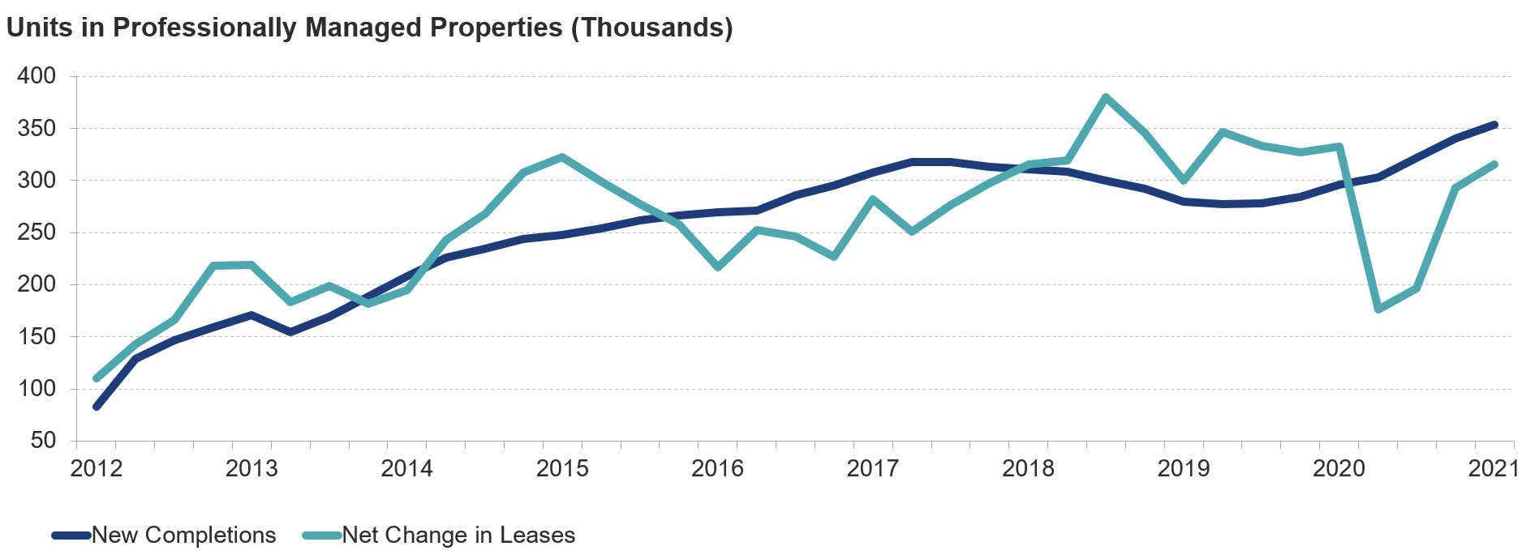
Figure 25: Additions to the Rental Supply Ramped Up During the Pandemic Even as Lease Rates Fell
Note: Data are four-quarter rolling averages for professionally managed apartment properties.
Source: JCHS tabulations of RealPage data.

Slide 26
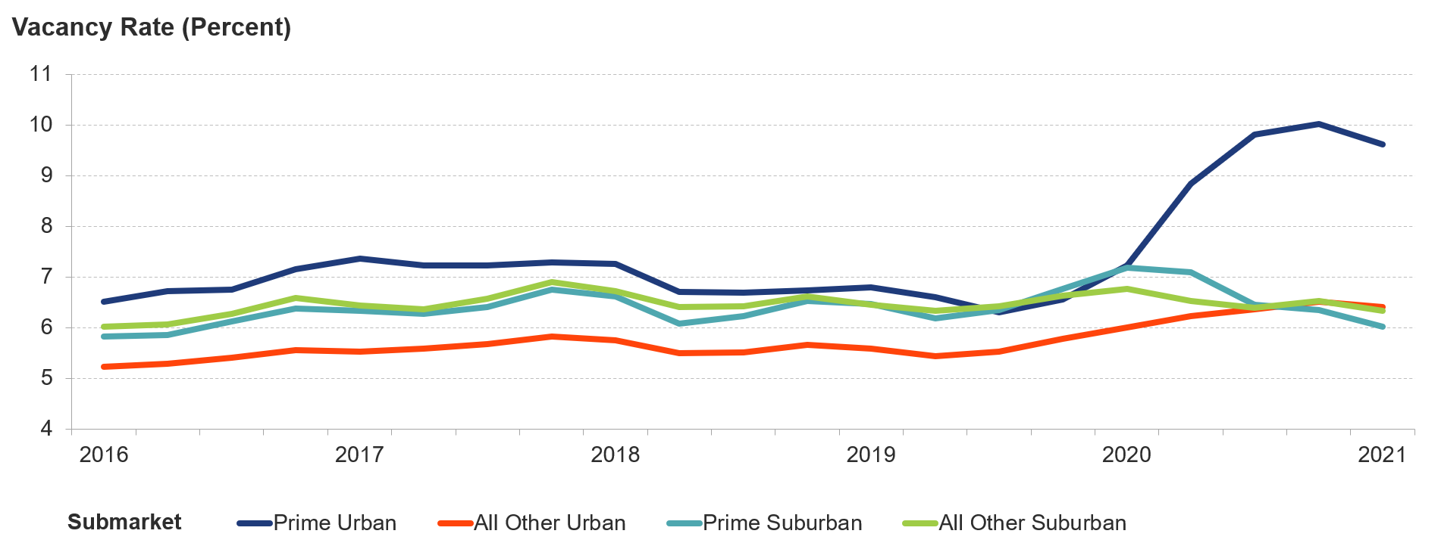
Figure 26: Vacancy Rates Soared in High-Rent Urban Areas Last Year, But Fell Steadily in Prime Suburban Markets
Notes: Urban/suburban areas are defined based on density in the 54 largest markets that CoStar tracks. Prime submarkets are those with the highest rents.
Source: JCHS tabulations of CoStar data.

Slide 27
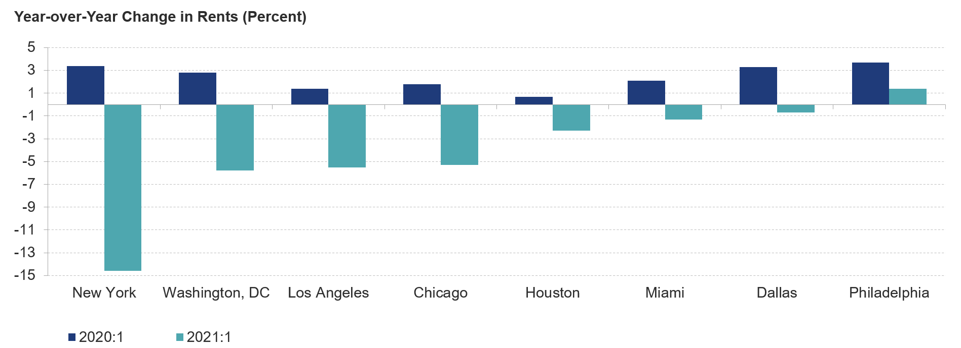
Figure 27: Rents in the Nation’s Eight Largest Markets Were Down Sharply in Early 2021
Note: Rent changes are for the eight largest metro areas by population in 2019.
Source: JCHS tabulations of RealPage data.

Slide 28
Figure 28: In Parts of the Northeast and Midwest, More than Half of Renter Households Live in Housing Built Before 1970
Share of Renters Living in
Pre-1970 Units (Percent)
Under 20
20-34
35-49
50 and Over
Note: The share of renter households living in housing units built before 1970 is measured at the core-based statistical area (CBSA) level.
Source: JCHS tabulations of US Census Bureau, 2019 American Community Survey 1-Year Estimates and Missouri Census Data Center Geocorr 2018.

Slide 29
Figure 29: Disproportionately Large Shares of Low-Income Households of Color Were Unable to Cover Their Housing Costs in Early 2021
Notes: Low-income households earned less than $25,000 in 2019. Black, white, and Asian households are non-Hispanic. Hispanic households may be of any race.
Source: JCHS tabulations of US Census Bureau, Household Pulse Surveys, January–March 2021.

Slide 30
Figure 30: Most Low-Income Households Spent Their Economic Impact Payments on Essentials Like Food, Utilities, and Housing
Notes: Low-income households earned less than $25,000 in 2019. Data only include households that received an economic impact payment during the seven days prior to the survey. Responses are not mutually exclusive. Debt includes credit card debt, student loans, and other liabilities.
Source: JCHS tabulations of US Census Bureau, Household Pulse Surveys, January–March 2021.

Slide 31
Figure 31: A Large Majority of Low-Income Renters Were Severely Cost Burdened Even Before the Pandemic
Notes: Cost-burdened (severely cost-burdened) households pay more than 30% (more than 50%) of income for housing. Households with zero or negative income are assumed to have burdens, while households paying no cash rent are assumed to be without burdens.
Source: JCHS tabulations of US Census Bureau, 2019 American Community Survey 1-Year Estimates.

Slide 32
Figure 32: The Number of People Experiencing Unsheltered Homelessness Climbed Again in 2020
Notes: Data are point-in-time estimates for late January in each year. People experiencing unsheltered homelessness are defined as sleeping in places not ordinarily used or meant for sleeping, including streets, parks, and vehicles. People in families with children are defined as members of a household with at least one adult and one child experiencing homelessness.
Source: JCHS tabulations of US Department of Housing and Urban Development, Annual Homeless Assessment Report Point-in-Time Estimates.

Slide 33
Figure 33: Households Behind on Rent or Mortgage Payments Often Face Other Hardships as Well
Share of Households Facing Hardships by Housing Payment Status (Percent)
Hardship | Behind on Payments | Up-to-Date on Payments
Difficulty Paying Expenses in the Past Week | 77 | 29
Symptoms of Depression or Anxiety | 60 | 38
Moderate or Severe Food Insufficiency | 37 | 8
Fair or Poor Health | 35 | 19
No Work in Past Week Due to COVID | 24 | 9
No Public/Private Health Insurance | 21 | 8
Notes: Every hardship is showing data from the first quarter of 2021 except for Fair or Poor Health, which is from the fourth quarter of 2020. Data include both renters and homeowners.
Source: JCHS tabulations of US Census Bureau, Household Pulse Surveys, September 2020–March 2021.

Slide 34
Figure 34: Spending on Homeowner Disaster Repairs Has Risen in Line with the Frequency of Severe Events
Notes: Billion-dollar disaster are adjusted to 2020 dollars using the CPI-U for All Items. The direct costs of disasters include physical damage to buildings, material assets, vehicles, infrastructure, and agriculture, as well as the costs of business interruption, wildfire suppression, and disaster restoration. Disaster repair expenditures are for homeowners only and are adjusted for inflation to 2019 dollars using the CPI-U for All Items. Disaster repair spending for 2013 uses Joint Center-adjusted weights.
Sources: JCHS tabulations of NOAA, Billion-Dollar Weather and Climate Disasters; HUD, American Housing Surveys.

