Slide 1
America’s Rental Housing 2020
Public Figure Data

Slide 2
Figure 1: High-Income Households Have Driven Most of the Growth in Renters Since 2010
Household Income
Note: Incomes are adjusted for inflation using the CPI-U for All Items.
Source: JCHS tabulations of US Census Bureau, American Community Survey 1-Year Estimates.

Slide 3
Figure 2: Strong Growth in High-Cost Rentals Has Coincided with Dramatic Declines in Low-Cost Units
Notes: Rental units may be occupied, vacant for rent, or rented but unoccupied; excludes units occupied without cash rent. Dollar values are adjusted for inflation using the CPI-U for All Items Less Shelter. Contract rent excludes all utilities paid separately.
Source: JCHS tabulations of US Census Bureau, American Community Survey 1-Year Estimates via IPUMS USA.

Slide 4
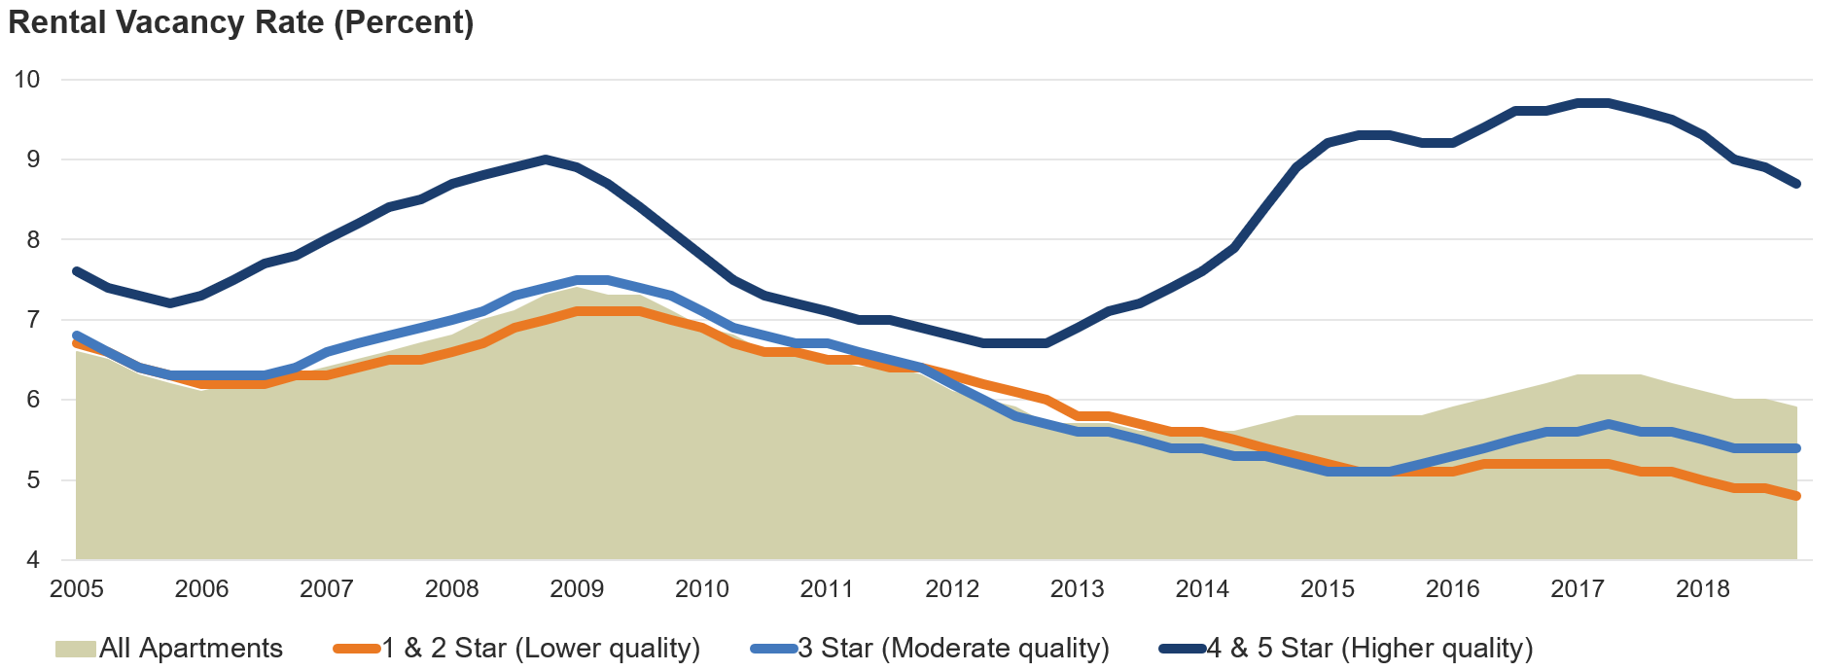
Figure 3: While Down Across in All Segments, Vacancy Rates for Moderate- and Lower-Quality Rentals Are Especially Low
Notes: Apartment quality is based on the CoStar Building Rating System for market-rate apartments in buildings with five or more units. Vacancy rates are four-quarter trailing averages.
Source: JCHS tabulations of CoStar data.

Slide 5
Figure 4: Despite Overall Improvement After 2011, Renter Cost-Burden Rates for Most Income Groups Have Been on the Rise
Share of Renter Households with Cost Burdens (Percent)
Notes: Household incomes are adjusted for inflation using the CPI-U for All Items. Moderately (severely) cost-burdened households pay more than 30% (more than 50%) of income for housing. Households with zero or negative income are assumed to have severe burdens, while households paying no cash rent are assumed to be without burdens.
Source: JCHS tabulations of US Census Bureau, American Community Survey 1-Year Estimates.

Slide 6
Figure 5: With Only Modest Growth in Federal Outlays, the Number of Assisted Households Has Been Essentially Flat
Notes: HUD rental assistance spending includes outlays for public housing capital and operating funds, Housing Choice Vouchers, project-based Section 8, Section 202, and Section 811. Outlays are adjusted for inflation using the CPI-U for All Items.
Sources: JCHS tabulations of US Department of Housing and Urban Development (HUD), Congressional Justifications and Picture of Subsidized Households.

Slide 7
Figure 6: Growth in Renter Households Has Slowed as Rentership Rates Stabilize
Note: Values for 2019 are year to date averages for the first three quarters.
Source: JCHS tabulations of US Census Bureau, Housing Vacancy Surveys.

Slide 8
Figure 7: Renters Are Increasingly Likely to Be Older, Minority, and Nontraditional Households
Notes: Other family households include relatives with no children under age 18. White, black, and Asian/other households are non-Hispanic. Hispanics may be of any race.
Source: JCHS tabulations of US Census Bureau, American Community Survey 1-Year Estimates.

Slide 9
Figure 8: High-Income Households Have Become a Much Larger Segment of the Rental Market
Household Income
Note: Household incomes are adjusted for inflation using the CPI-U for All Items.
Source: JCHS tabulations of US Census Bureau, American Community Survey 1-Year Estimates.

Slide 10
Figure 9: Most of the Growth in High-Income Renters Has Been Among College-Educated Households that Are Married, White, and Young
Notes: Incomes are adjusted for inflation using the CPI-U for All Items. High-income households earn at least $75,000 a year. Married families include married couple households with or without children. Other families include single parents. White, black, and Asian/other households are non-Hispanic. Hispanics may be of any race.
Source: JCHS tabulations of US Census Bureau, American Community Survey 1-Year Estimates.

Slide 11
Figure 10: With Gains Largely at the Top of the Income Distribution…
Notes: Income quintiles are for renters only. Dollar values are adjusted for inflation using the CPI-U for All Items.
Source: JCHS tabulations of US Census Bureau, Current Population Survey via IPUMS-CPS.

Slide 12
Figure 11: …Inequality Among Renter Households Has Increased Sharply Over the Past Three Decades
Notes: Income quintiles are for renters only. Dollar values are adjusted for inflation using the CPI-U for All Items.
Source: JCHS tabulations of US Census Bureau, Current Population Survey via IPUMS-CPS.

Slide 13
Figure 12: Household Mobility Rates Have Declined Steadily Among Renters of All Ages
Source: JCHS tabulations of US Census Bureau, Current Population Surveys via IPUMS-CPS.

Slide 14
Figure 13: Single-Family and Large Multifamily Properties Account for Most of the Growth in Rentals Over the Last Decade
Number of Rental Units (Millions)
Structure Type
Note: Rental units may be occupied, vacant for rent, or rented but unoccupied.
Source: JCHS tabulations of US Census Bureau, American Community Survey 1-Year Estimates.

Slide 15
Figure 14: New Construction of Large Multifamily Buildings Has More than Offset the Decline in Single-Family Rentals
Net Change in Rental Units (Thousands)
Number of Rental Units (Millions)
Note: Rental units may be occupied, vacant for rent, or rented but unoccupied.
Source: JCHS tabulations of US Census Bureau, American Community Survey 1-Year Estimates.

Slide 16
Figure 15: The Types of Units Available to Renters Vary Widely from Region to Region…
Share of Rental Stock (Percent)
Structure Type
Notes: Rental units may be occupied, vacant for rent, or rented but unoccupied. Manufactured housing includes other structures, such as boats, RVs, and automobiles.
Source: JCHS tabulations of US Census Bureau, 2018 American Community Survey 1-Year Estimates.

Slide 17
Figure 16: …with Low-Cost Units Concentrated Primarily in the Midwest and South
Share of Rental Stock (Percent)
Notes: Rental units may be occupied, vacant for rent, or rented but unoccupied. Contract rents exclude utility costs paid separately.
Source: JCHS tabulations of US Census Bureau, 2018 American Community Survey 1-Year Estimates.

Slide 18
Figure 17: Regardless of Age, Apartments in Small Multifamily Buildings Rent for Significantly Less than Other Units
Median Contract Rent (Dollars)
Structure Type
Notes: Rental units may be occupied, vacant for rent, or rented but unoccupied. Contract rent excludes utilities paid separately.
Source: JCHS tabulations of US Census Bureau, 2018 American Community Survey 1-Year Estimates.

Slide 19
Figure 18: Spending on Capital Improvements Has Soared Since 2010, Far Outpacing Investment in Basic Maintenance
Spending on Rental Properties (Billions of 2018 dollars)
Notes: Improvements include remodels, replacements, additions, structural alterations, and other activities that increase the value of the housing stock. Routine maintenance and repair projects preserve the current quality of homes. Spending is adjusted for inflation using the CPI-U for All Items.
Source: JCHS tabulations of HUD, Rental Housing Finance Surveys; US Department of Commerce, Retail Sales of Building Materials; and National Apartment Association (NAA), Surveys of Operating Income & Expenses.

Slide 20
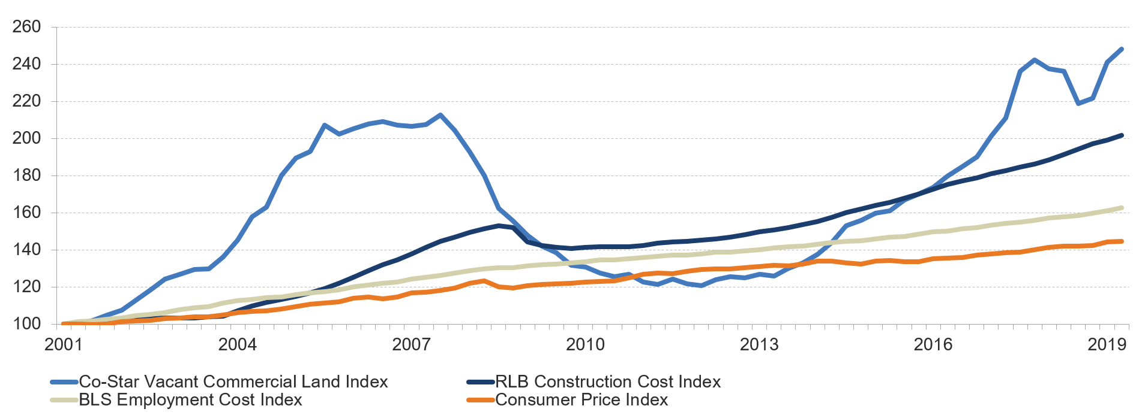
Figure 19: Construction, Labor, and Land Costs Continue to Climb Much Faster than Inflation
Index
Notes: The CoStar Vacant Commercial Land Index serves as a proxy for price changes of developable multifamily sites. The RLB Construction Cost Index measures the bid cost of commercial construction, including labor, building materials, contractor fees, and applicable taxes.
Source: JCHS tabulations of CoStar Vacant Commercial Land Index; RLB Construction Cost Index; and US Bureau of Labor Statistics (BLS), Consumer Price Index for All Urban Consumers and Employment Cost Index.

Slide 21
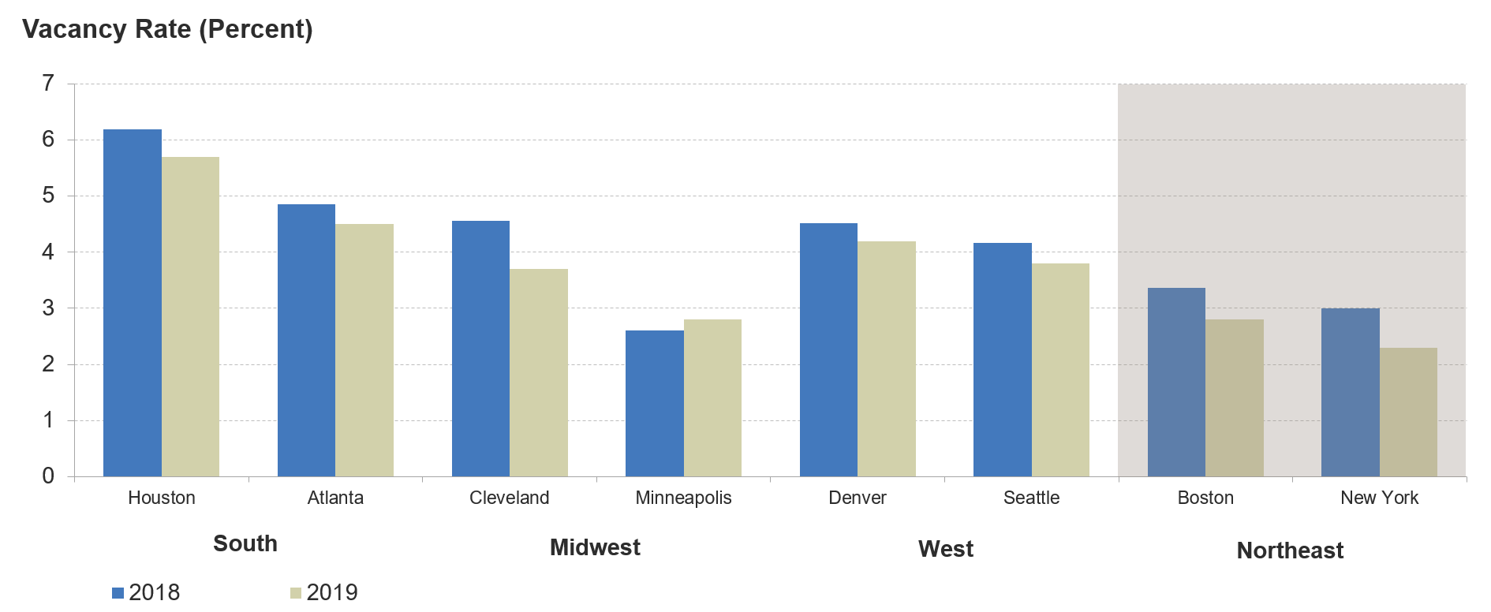
Figure 20: Apartment Vacancy Rates Continued to Fall Across Metro Areas in 2019
Note: Vacancy rates are for professionally managed apartments as of the third quarter of both years.
Source: JCHS tabulations of RealPage data.

Slide 22
Figure 21: Rents Continue to Climb Much Faster than General Inflation
Annual Change (Percent)
Note: Changes are four-quarter rolling averages.
Source: JCHS tabulations of BLS, Consumer Price Indexes.

Slide 23
Figure 22: Multifamily Construction Remains Near Decades-Long Highs, With Almost All Units Intended as Rentals
Structure Type
Note: Starts in 2019 are the four-quarter trailing average as of the third quarter.
Source: JCHS tabulations of US Census Bureau, New Residential Construction data.

Slide 24
Figure 23: Most New Rentals Are Located in the Core Counties of Large Metros…
Notes: Small metros have populations under 250,000. Medium metros have populations between 250,000 and 1 million. Large metros have populations over 1 million. Core counties in large metros contain either the largest city or any city with 250,000 residents; non-core counties are all other counties in the metro area.
Source: JCHS tabulations of US Census Bureau, New Residential Construction data and the Building Permits Survey.

Slide 25
Figure 24: … and Concentrated in Multifamily Structures with at Least 50 Units
Units in Structure
Source: JCHS tabulations of US Census Bureau, New Residential Construction data and Building Permits Survey.

Slide 26
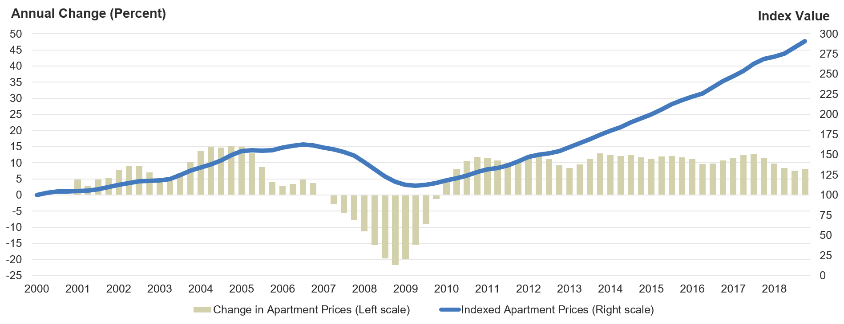
Figure 25: After Nine Years of Strong Growth, Apartment Property Prices Have Nearly Tripled Since 2010
Source: JCHS tabulations of Real Capital Analytics, Commercial Property Price Indexes.

Slide 27
Figure 26: The Government Agency Share of the Multifamily Loan Market Increased to Nearly Half Between 2013 and 2018
Share of Multifamily Loan Originations (Percent)
2013
2018
Notes: CMBS are commercial mortgage-backed securities. Banks include thrifts and savings & loans. Other includes capital sources not elsewhere classified, including investor-driven lenders like mortgage REITs, debt funds, and finance companies.
Source: JCHS tabulations of Mortgage Bankers Association, Commercial Real Estate/Multifamily Finance Database.

Slide 28
Figure 27: Both the Number and Share of Cost-Burdened Renters Remain Near Record Highs
Notes: Moderately (severely) cost-burdened households pay more than 30% (more than 50%) of their income for housing. Households with zero or negative income are assumed to have burdens, while households paying no cash rent are assumed to be without burdens.
Source: JCHS tabulations of US Census Bureau, American Community Survey 1-Year Estimates.

Slide 29
Figure 28: Increasing Shares of Middle-Income Renters Have Cost Burdens, Particularly in Large Metros
Household Income of $45,000–74,999
Notes: Cost-burdened households pay more than 30% of income for housing. Households with zero or negative income are assumed to have burdens, while households paying no cash rent are assumed to be without burdens. Household incomes are adjusted for inflation using the CPI-U for All Items.
Source: JCHS tabulations of US Census Bureau, American Community Survey 1-Year Estimates and Missouri Census Data Center data.

Slide 30
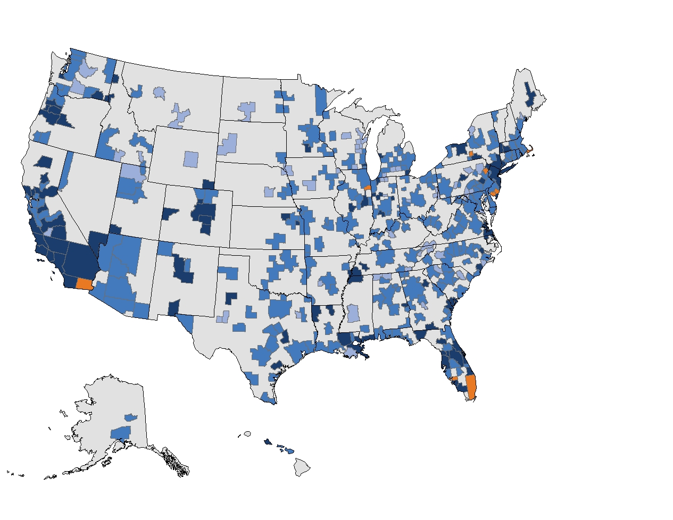
Figure 29: At Least 40 Percent of Renters Are Cost Burdened in Metro Areas Across the Country
Share of Renters with
Cost Burdens (Percent)
Under 40
40–49
50–59
60–67
Notes: Cost-burdened households pay more than 30% of income for housing. Households with zero or negative income are assumed to have burdens, while households paying no cash rent are assumed to be without burdens.
Source: JCHS tabulations of US Census Bureau, 2018 American Community Survey 1-Year Estimates and Missouri Census Data Center data.

Slide 31
Figure 30: Low-Income Renters Spend Disproportionately Large Shares of Their Incomes on Housing, Transportation, and Energy Costs
Household Income
Household Expense
Notes: Data include only renters with wage or salary income that pay separately for at least one energy expense. Rent does not include utility costs. Energy costs include expenses for electricity, gas, fuel oil, and other fuels. Commuting costs include out-of-pocket expenses (e.g., for tolls, parking, public transportation) and a mileage-based cost calculation for driving to work.
Source: JCHS tabulations of HUD, 2017 American Housing Survey.

Slide 32
Figure 31: High Housing Costs Prevent Vulnerable Renter Households from Spending on Basic Health Needs
Households with Children Under 18
Households Headed by Adults Age 65 and Over
Notes: Lowest-income households are in the bottom expenditure quartile. Households are considered unburdened (severely burdened) if housing accounts for less than 30% (more than 50%) of expenditures.
Source: JCHS tabulations of BLS, 2018 Consumer Expenditure Survey.

Slide 33
Figure 32: Low-Cost Units Account for a Shrinking Share of the Nation’s Rental Stock
Share of Units with Real Contract Rents Under $600 (Percent)
Notes: Rental units may be occupied, vacant for rent, or rented but unoccupied; exclude those occupied without cash rent. Dollar values adjusted for inflation using the CPI-U for All Items Less Shelter. Contract rents exclude utility costs paid separately.
Source: JCHS tabulations of US Census Bureau, American Community Survey 1-Year Estimates via IPUMS USA.

Slide 34
Figure 33: The Supply of Federally Subsidized Units Has Remained Essentially Flat Since 2010
Notes: LIHTC occupied units are based on the 96% average occupancy rate reported in HUD, Understanding Whom the LIHTC Program Serves, 2017. LIHTC units are affordable to households making 50–60 percent of area median income. USDA multifamily units are in USDA Section 514 and Section 515 properties.
Source: JCHS tabulations of HUD, Picture of Subsidized Households and Low-Income Housing Tax Credit Database; USDA, Multi-Family Housing Annual Fair Housing Occupancy Reports.

Slide 35
Figure 34: State and Local Agencies Have Stepped Up Bond Issuances to Help Expand the Affordable Supply
Notes: Totals include tax-exempt bonds issued by a state, county, or municipal agency that closed between January 1, 2008 and December 31, 2018. Bond amounts are adjusted for inflation using the CPI-U for All Items.
Source: JCHS tabulations of Municipal Securities Rulemaking Board, Electronic Municipal Market Access data.

Slide 36
Figure 35: Native American Households in Rural Areas Face High Rates of Overcrowding and Housing Inadequacy
Notes: Data include only renter households living outside of metro and micro areas. Overcrowding is defined as more than one person per room. Inadequate housing units lack complete kitchen facilities or plumbing. Native American, Asian/other, black, and white households are non-Hispanic. Hispanics may be of any race.
Source: JCHS tabulations of US Census Bureau, 2018 American Community Survey 1-Year Estimates and Missouri Census Data Center data.

Slide 37
Figure 36: Lower-Income Minority Households Are the Most Likely to Come Under Threat of Eviction
Notes: Respondents reported being threatened with eviction in the three months prior to the survey. Black, Asian/other, and white households are non-Hispanic. Hispanics may be of any race.
Source: JCHS tabulations of HUD, 2017 American Housing Survey.

Slide 38
Figure 37: The Unsheltered Population Continued to Grow in 2018 as the Number of Beds for the Homeless Declined
Homeless Beds (Thousands)
Note: Homeless beds include permanent supportive housing, emergency shelters/safe havens, transitional housing, and rapid rehousing.
Source: JCHS tabulations of HUD, 2018 Annual Homeless Assessment Report and Housing Inventory Counts.

Slide 39
Figure 38: More than 10 Million Renters Live in Areas Prone to Natural Disasters
Number of Renter Households
in High-Loss Zip Codes
Low-Loss Areas
0–9,999
10,000 and Over (Up to 706,000)
Notes: High-loss zip codes had at least $1 million in disaster-related business and home losses in 2008–2018. Disaster-related losses are adjusted for inflation using the CPI-U for All Items. The number of renters in high-loss zip codes are aggregated to the county level.
Source: JCHS tabulations of US Small Business Administration, Disaster Loan data; US Census Bureau, American Community Survey 5-Year Estimates.

